Slide 1
Getting Started with Eduthings
Career Exploration, Endorsement Selection, Four Year Planning
http://www.free-powerpoint-templates-design.com

Slide 2
1
Log in to Clever
2
Log in to
Eduthings

Slide 3
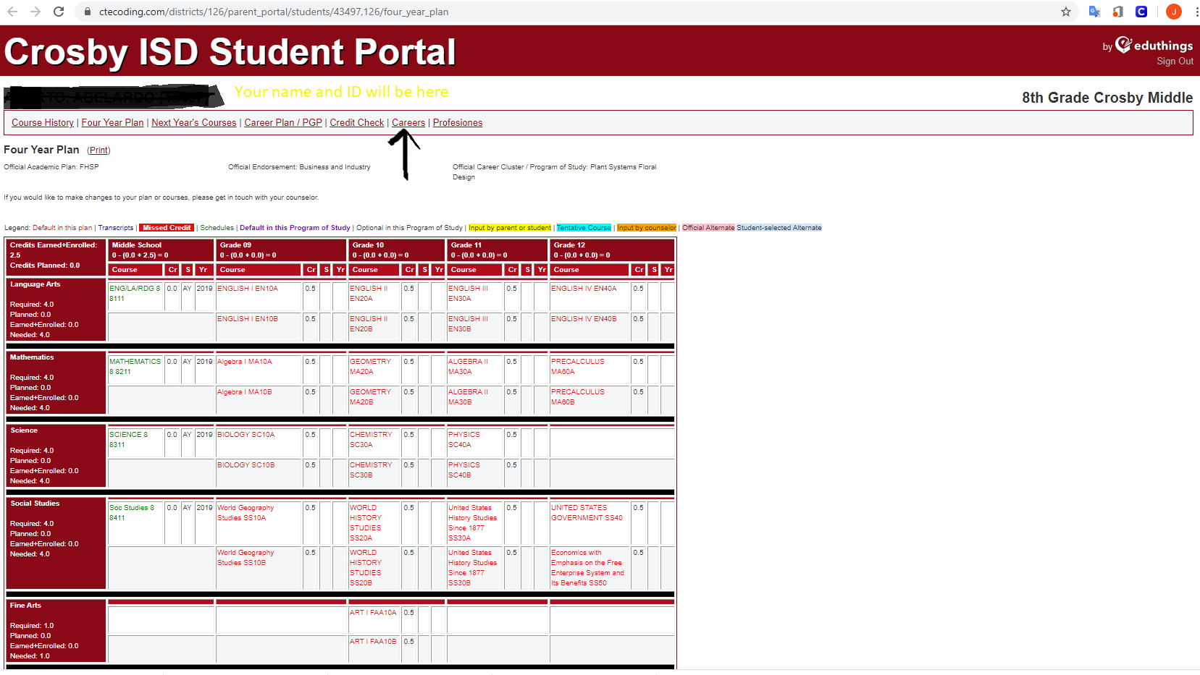
You will see the Home Screen. Click on Careers.
3

Slide 4
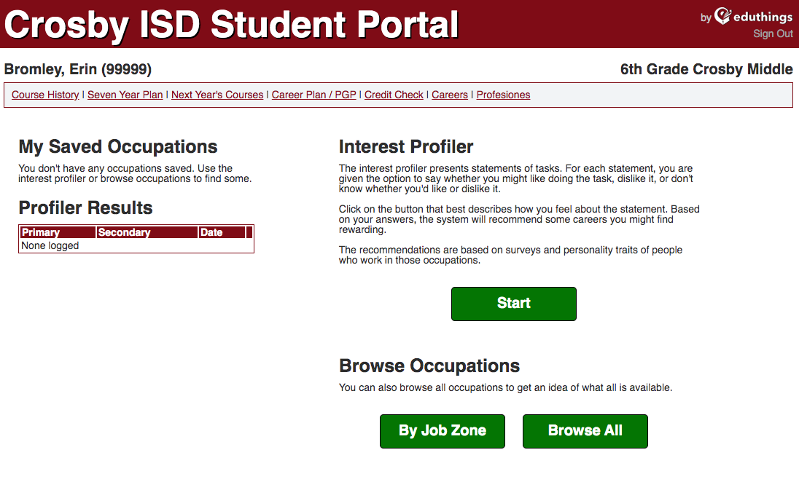
Click on Start under Interest Profiler and take the Quiz
Student Name (ID #)
4

Slide 5
Profile Questions
Each question (20-25) will ask you if you like certain tasks or jobs. You will click on Like,
Don’t Know, or Dislike. Answer the question honestly and accurately because this is the information that will be used during scheduling. This step is VERY important.
5

Slide 6
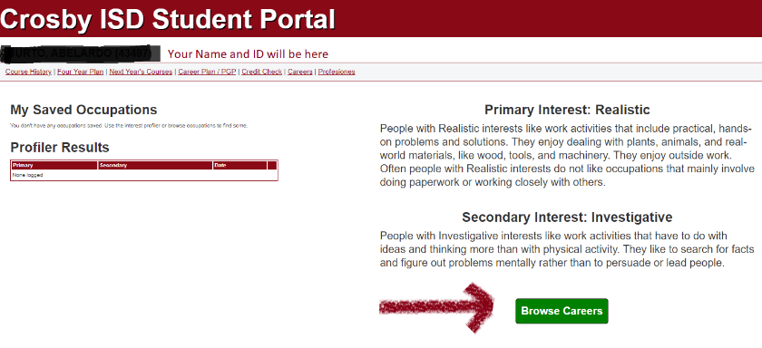
Based on your answers, you will have a Primary Interest and a Secondary Interest. Click on Browse Careers
6

Slide 7
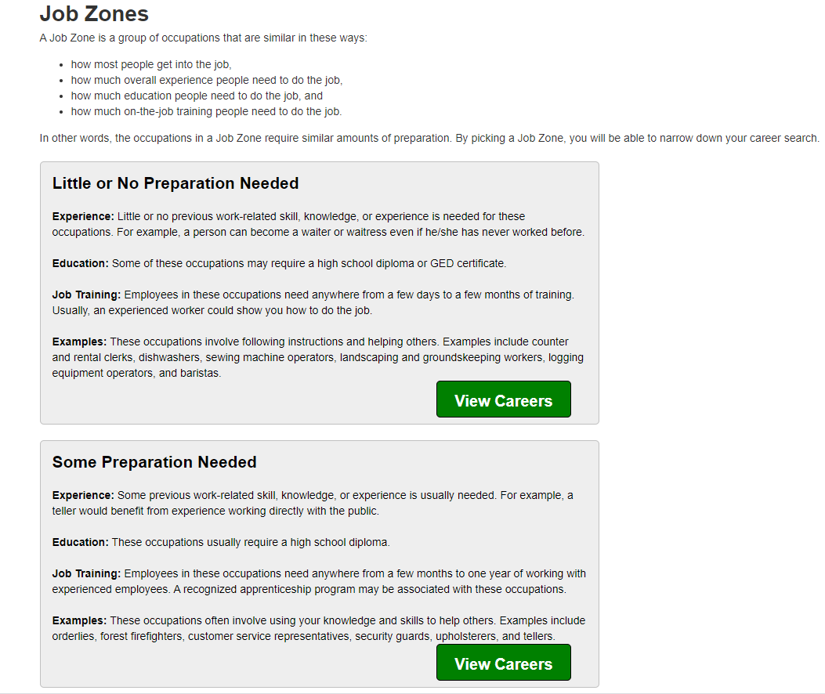
You will look at careers based on the how much and what kind of preparation you want to do (i.e. how much college and/or training are you willing to do for the career).
7

Slide 8
Career Preparation (continued.)
Little or No Preparation (a high school diploma or certificate)
Some Preparation (need 6 months – 1 year minimum job related
experience)
Medium Preparation (1-2 years of job training or a 2 year/Associate
Degree in a related field)
Considerable Preparation (4 year/Bachelor’s Degree in related field)
Extensive Preparation (a post-graduate/Master’s Degree or a
doctoral/Ph.D. in a related field – doctor, lawyer, etc.)
The more preparation you are willing to do, the better the job possibilities.
7
Continued

Slide 9
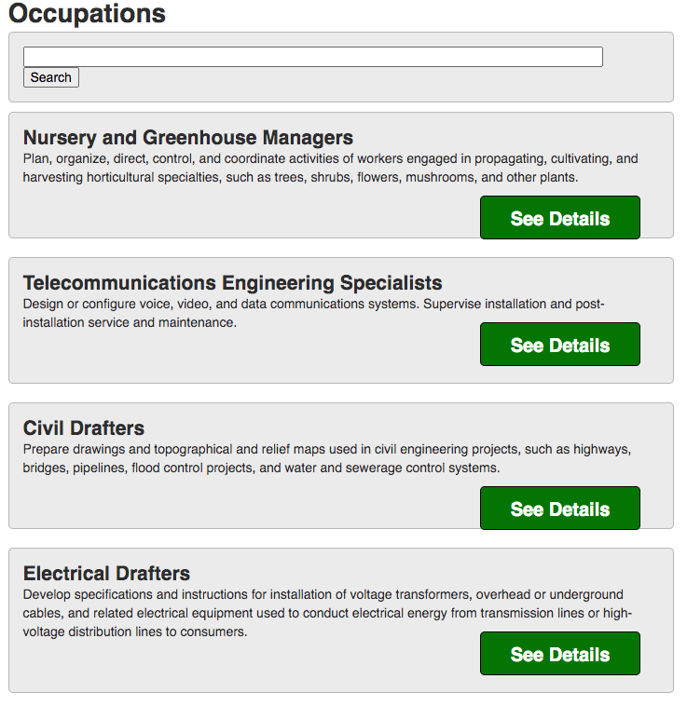
Career/Job List
When you see a career or job that sounds interesting, click on See Details.
8

Slide 10
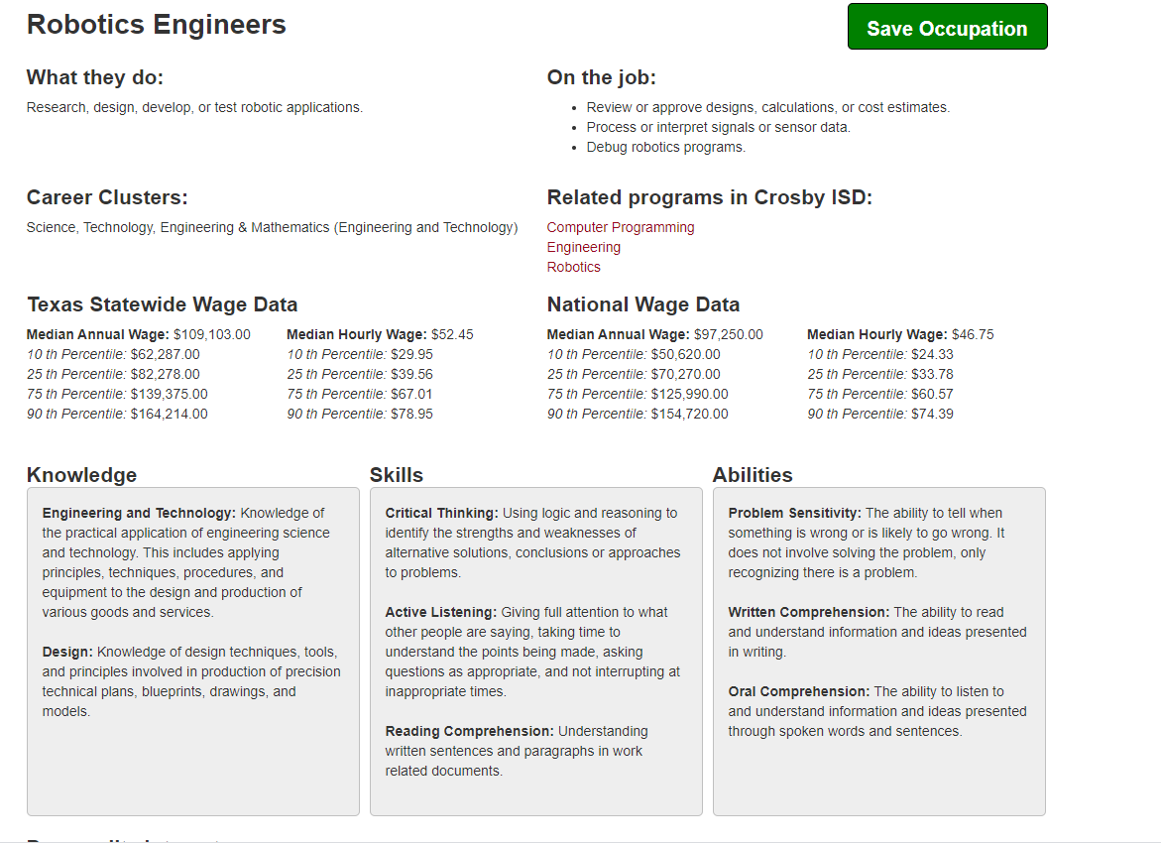
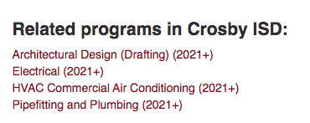
You will see information about that career. If you like it, check to see if Crosby has Related Programs you can take.
9
If it looks interesting to you, click on Save Occupation.

Slide 11
If nothing interests you, click on careers and you can search by
Job Zone or Browse All Careers
10

Slide 12
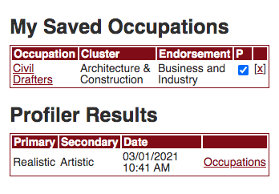
Once you have selected and saved careers you are interested in, click on Careers again to return to the profiles screen.
On the left side of the screen will be
My Saved Occupations and
Profiler Results
Once you have decided which saved career you are MOST interested in, you will click in the box under the P.
11

Slide 13
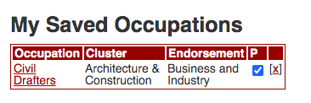
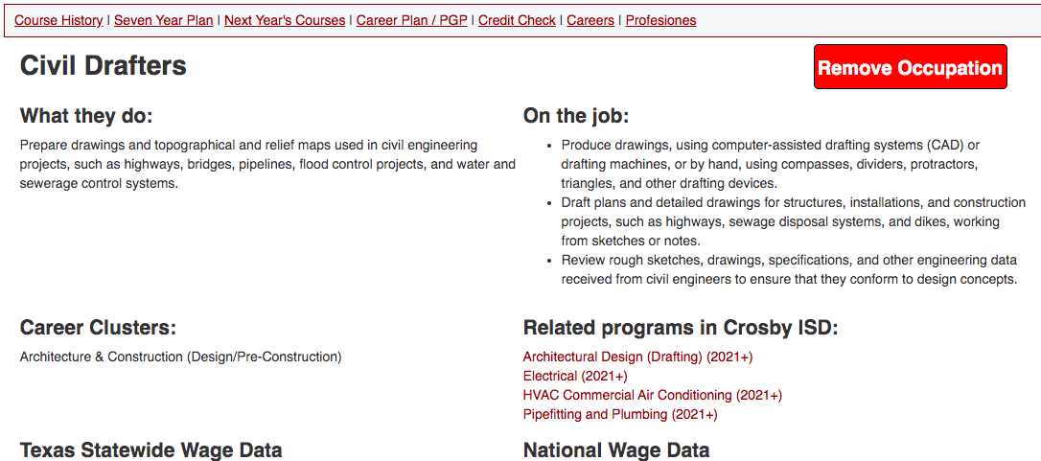
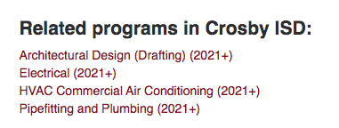
After you select your top
career choice, click on
the link for that occupation.
12
This will take you back to the detailed information about your top career choice.
Click on the Related Program in
Crosby ISD that interests you.

Slide 14
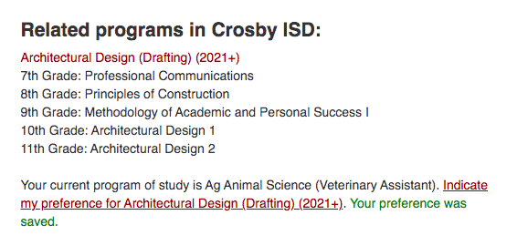
Clicking on Related Program (continued)
Once you click on the Related Program, you will need to
click on Indicate my preference for XXXX … and a green
message will appear that says Your preference has been saved.
12
continued
This is a
critical step !!!!!

Slide 15
Next Step:
Scheduling!
Dates to Be Announced.

